Slide 1
Survival Analysis
Tomas Bencomo and Kyle W. Singleton, PhD

Slide 2
About Us
PhD Biomedical Engineering - Informatics
Graduated High School
B.S. Candidate Computer Science

Slide 3
A Quick Disclaimer
Not a statistician
Not a statistician
PhD Biomedical Engineering - Informatics
Graduated High School
B.S. Candidate Computer Science
Although we have both received formal statistics training, when in doubt consult a statistician.

Slide 4
Roadmap
Statistics Review
Designing the Analysis
Analysis Methods
Interpreting Statistics

Slide 5
Why Give This Talk?
“To consult the statistician after an experiment is finished is often merely to ask him to conduct a post mortem examination. He can perhaps say what the experiment died of.”
- Ronald Fisher

Slide 6
Hypothesis Testing Evaluates Evidence
Define hypotheses
H₀: Null hypothesis
T, Z, Proportion, Mean
Determine effect size/power
H₁: Alternative hypothesis
Determine test statistic
Etc.
Collect and prepare data
Compute statistic
Get p-value
Analyze evidence
Don't dichotomize the p-value

Slide 7
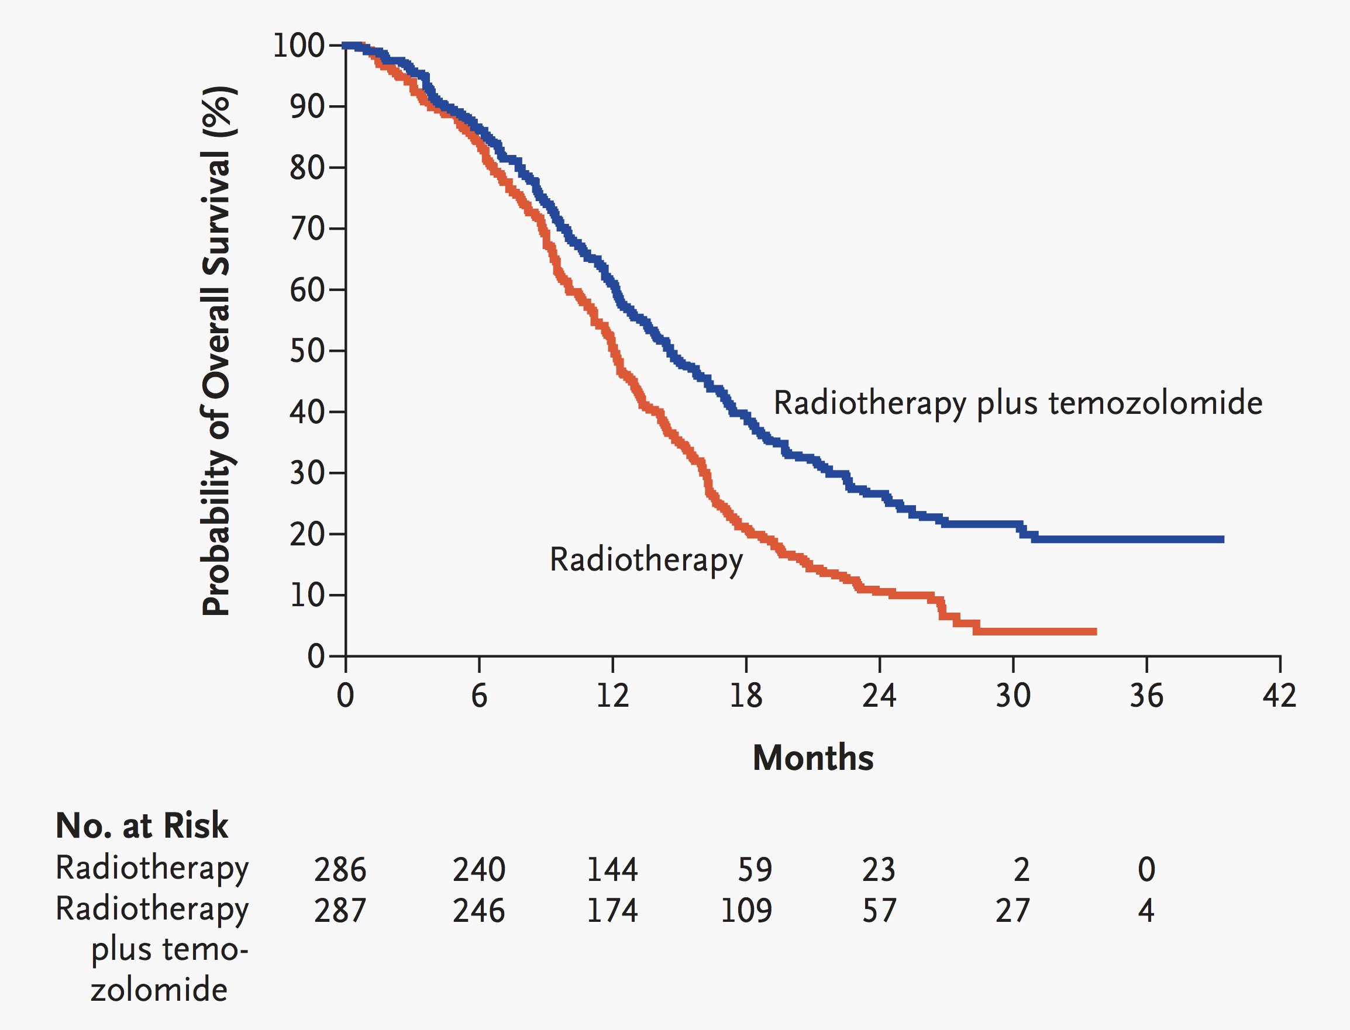
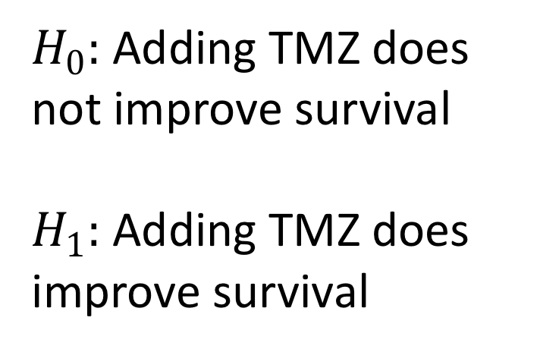
Hypothesis in Survival
$H_{0}:$ Adding TMZ does not improve survival
$H_{1}:$ Adding TMZ does improve survival
Stupp R et al. N Engl J Med 2005;352:987-996.

Slide 8
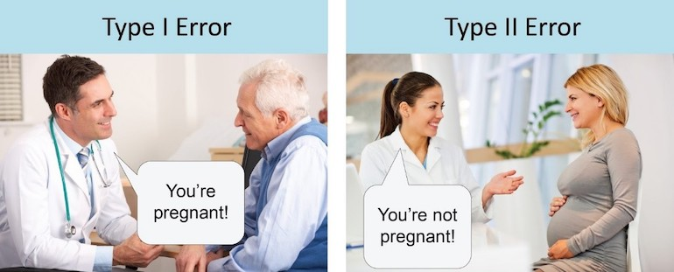

Hypothesis Tests Can Make Mistakes
$H_{0}$: The patient is not pregnant
$H_{1}$: The patient is pregnant

Slide 9
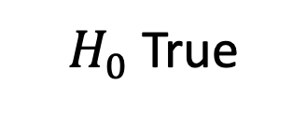
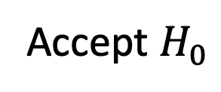
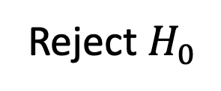
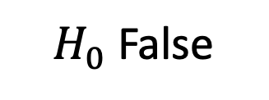
Decision Errors
$H_{0}$True
$H_{0}$False
We decide to:
Reject $H_{0}$
False Positive
Type I Error
True Negative
True Positive
False Negative
Type II Error
Accept $H_{0}$

Slide 10
Experimental Design Is Critical
Observational Study
Collect data without intervening
Confounding and covariate imbalance major concern
Notorious for mixed results
Randomized Trial
Randomly assign patients to different groups
Randomization deals with covariate imbalances
Gold standard of evidence in medicine

Slide 11
Observational Data Is Messy
UK Biobank Data: Exome data and Cardiac MRI saves lives?
Exome=0
No Cardiac MRI
Exome=1
Has Cardiac MRI
James Pirruccello Tweetorial on UK Biobank Immortal Time Bias 2019 - https://twitter.com/jpirruccello/status/1152252597723701249

Slide 12
Observational Data Is Messy
Not so fast!!! We should examine from date of first MRI.
Exome effect was just a
proxy for who got an MRI!
MRI has no effect on
mortality!
Exome=0
No Cardiac MRI
Exome=1
Has Cardiac MRI
Observational studies have lots of issues that statistical tests won’t catch! Be careful and don’t blindly analyze data.
James Pirruccello Tweetorial on UK Biobank Immortal Time Bias 2019 - https://twitter.com/jpirruccello/status/1152252597723701249

Slide 13
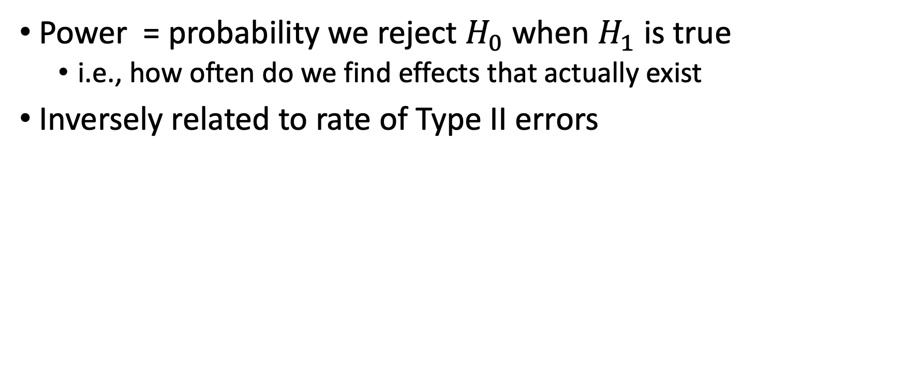
Statistical Power
Power = probability we reject $H_{0}$ when $H_{1}$ is true
i.e., how often do we find effects that actually exist
Inversely related to rate of Type II errors
Power = Type II Error

Slide 14
Let’s Get Real About Power
Assume treatment improves survival by 25% (HR = .75)
GBM almost always lethal - assume 90% of patients die
50-50 split between treatment and control groups
Need lots of patients to have any chance of finding effect!
Sample | Power
20 | 9%
100 | 27%
400 | 78%
800 | 97%
http://powerandsamplesize.com/Calculators/Test-Time-To-Event-Data/Cox-PH-2-Sided-Equality

Slide 15
Designing the Analysis
The most important part!

Slide 16

What Question Are We Trying to Answer
Asking the right research questions is crucial!
Question needs to be well-defined
Define relevant effect size and power accordingly
Confirmatory analysis – prespecified questions
Exploratory analysis – hypothesis generating

Slide 17
Sample Size Is Important
Sample size affects power
More samples → more precision to detect smaller effect
N = number of events NOT patients
Adding covariates requires more events
(Bad) rule of thumb: 15 events per variable (EPV)
In reality EPV much more complicated
Subgroup heterogeneity harder to detect due to smaller N
Often need 4N patients

Slide 18
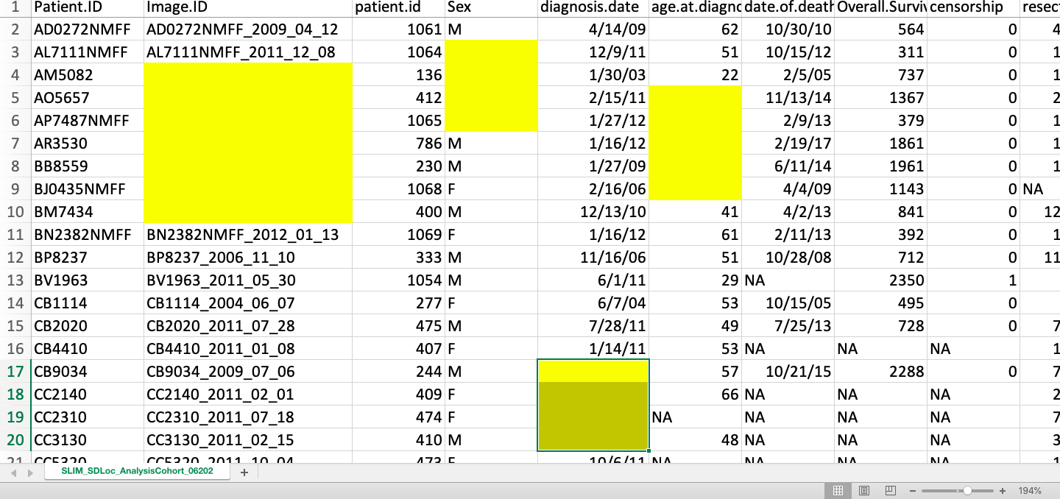
Don’t Discard Patients Missing Data
Missing data decreases sample size
Smaller sample → decreased power
Why is data missing?
Missing at random (MAR)
Relatively safe to exclude (better to impute!)
Informative missing (MI)
e.g., patients missing labs b/c died before labs could be collected
Simply excluding these patients could bias results
Before fixing data, explore patterns in missing variables

Slide 19
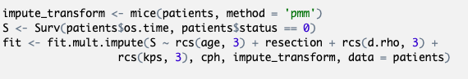
Imputation Gives Us The Power
Idea: Can we guess these missing values?
Imputation lets us guess data that is MAR
Better to guess missing values than reduce sample size
MICE imputation guesses data from non-missing data
Imputing multiple times maintains inference validity

Slide 20
Imputation Guidelines
How much is missing? | Recommendations
Less than 3% | Median imputation or exclude patients with missing data
Greater than 3% | MICE with max(5, 100x) imputations
Multiple predictors frequently missing | Sensitivity analysis with more imputations

Slide 21
Univariate Feature Selection is Bad
Common to screen variables with univariate model
Then only include significant variables in final model
This is a form of stepwise variable selection
9/10 of statisticians agree: don’t use stepwise variable selection!
Attiyeh et al. 2004

Slide 22
What Variables Do We Include in Our Model?
Sample size can limit number of variables to include
Variable selection procedures can impact inference
Select features incorrectly → exaggerate results
https://xkcd.com/1838/

Slide 23
How To Choose Features
Proper selection strategies:
Domain expert specifies relevant variables
Use all variables and apply shrinkage
Data reduction blinded to response
Leave insignificant in model – still add to predictions
Think about relevant confounders
Don’t Make Me Choose!
Akash Desarda – TowardsDataScience

Slide 24
Analyzing Our Data
The fun part!

Slide 25
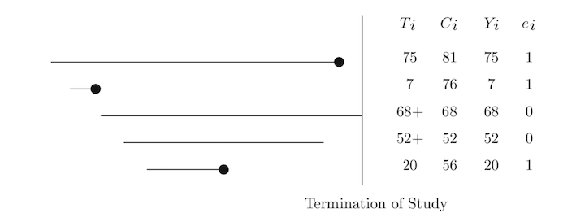
Survival Analysis
Measuring time to an event
Death, Myocardial infarction, Tumor recurrence, Rubber band failure
Patients either:
Experience the event
Are censored before the event is observed (lost to follow-up)
Coded as 1 = event and 0 = censored
Analyzing time survived vs binary dead/alive increases power
http://www.alphabetastats.com/?page_id=265

Slide 26
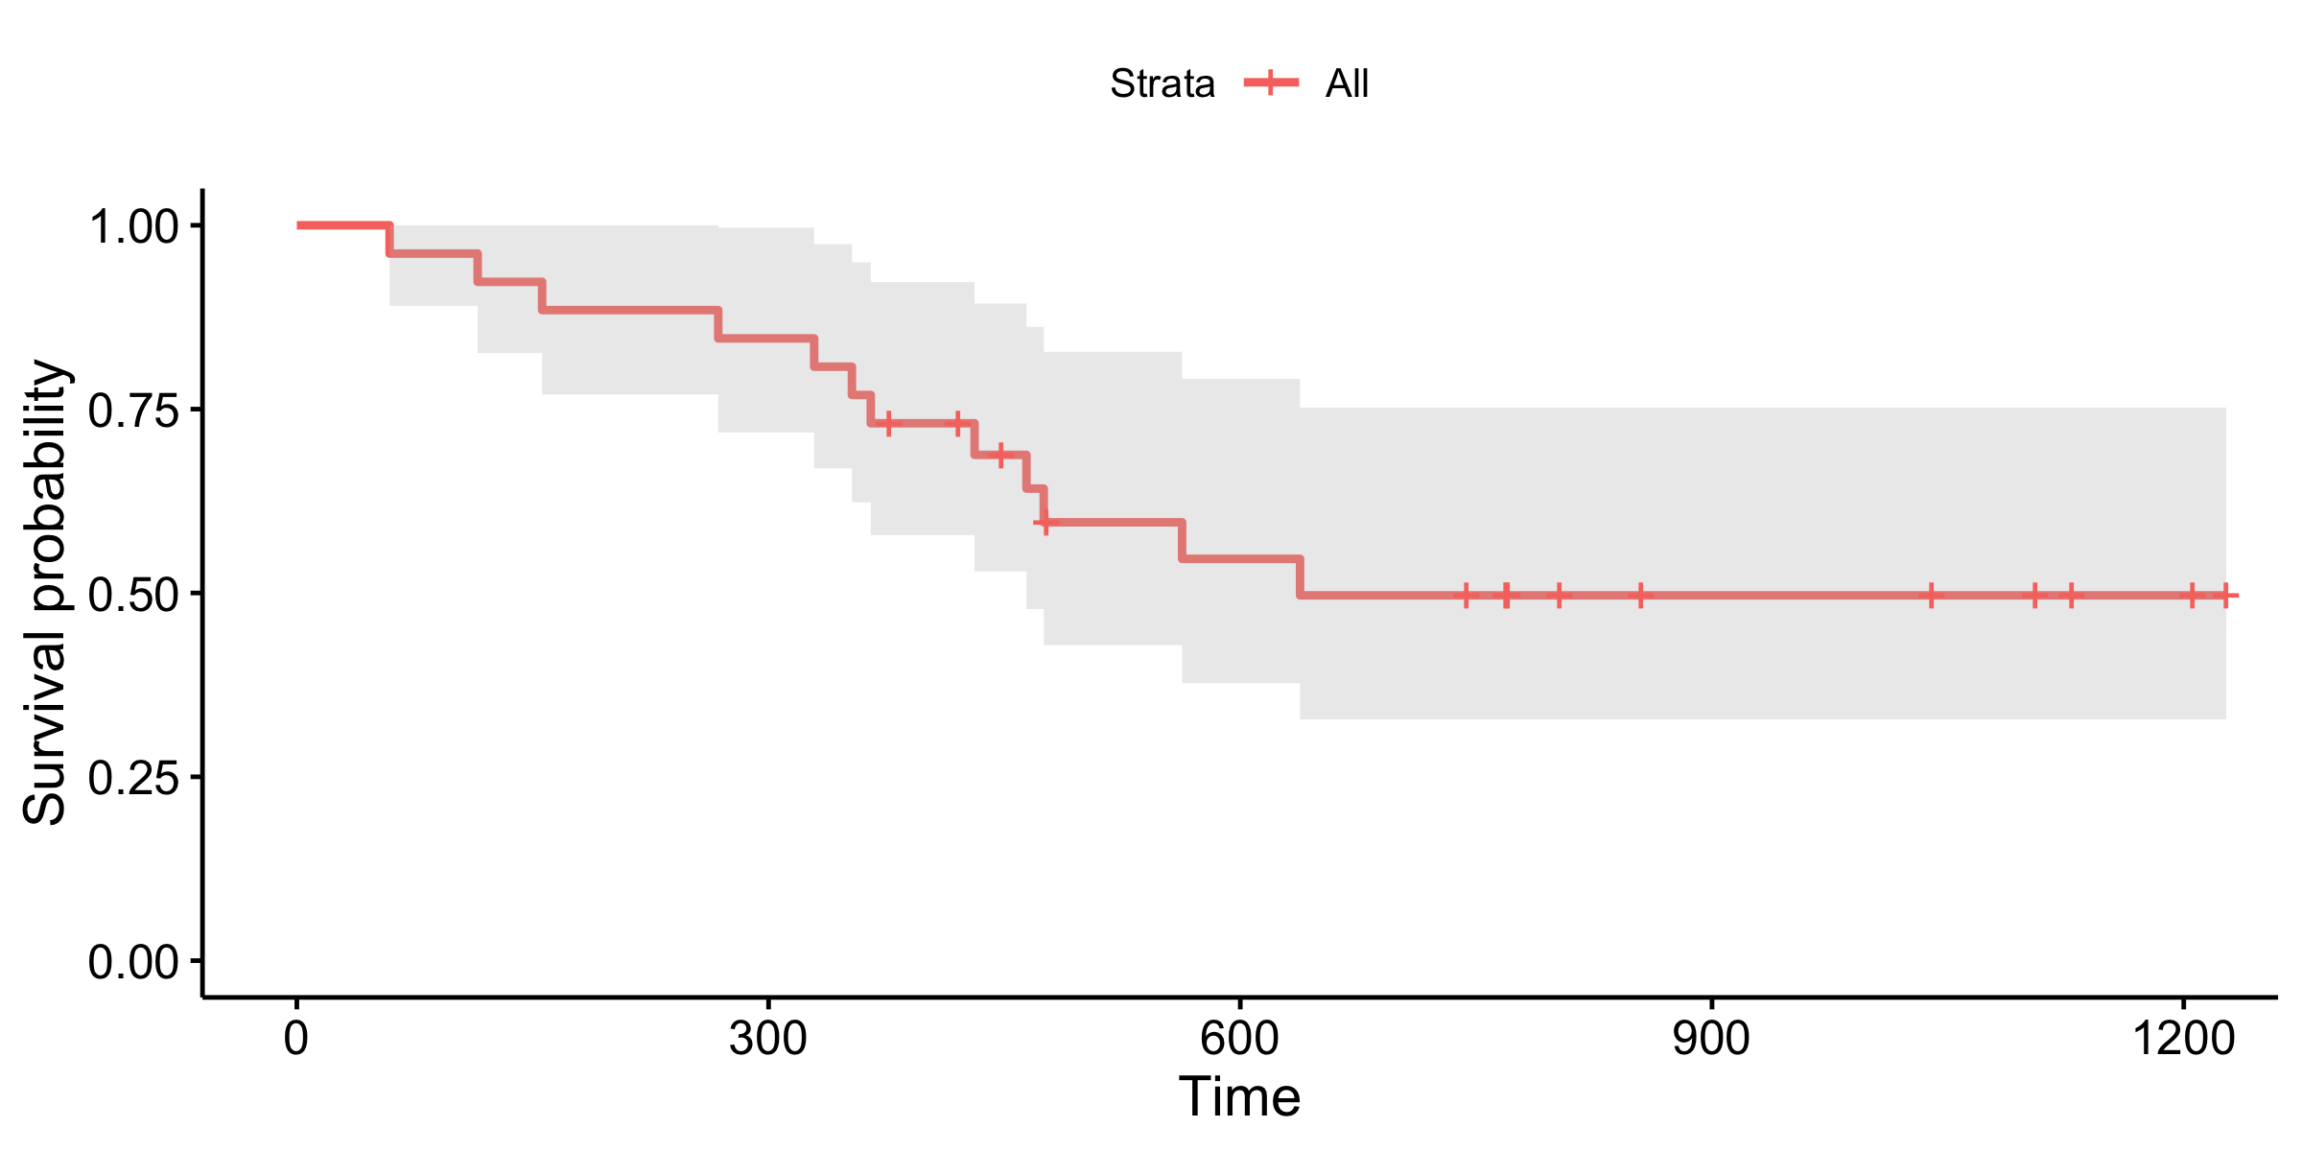
Kaplan-Meier Estimate
Computes probability of event at time t
Needed to handle censoring
Great for summary statistics describing patient prognosis

Slide 27
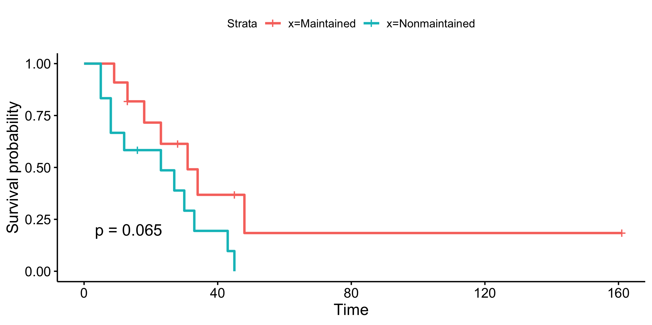
Kaplan-Meier compares survival difference
Log rank test - Test to compare survival between 2 groups

Slide 28
Should I use a Kaplan-Meier?
Yes!
No!
I have a discrete variable
Patients were randomized
I want to show summary statistics
Examples
Male vs. Female
No treatment vs. treatment
Treatment A vs. B vs. C
I have a continuous variable
My variable is observational
I need to adjust for other variables
Examples
Age
Velocity
D/rho
Cholesterol

Slide 29
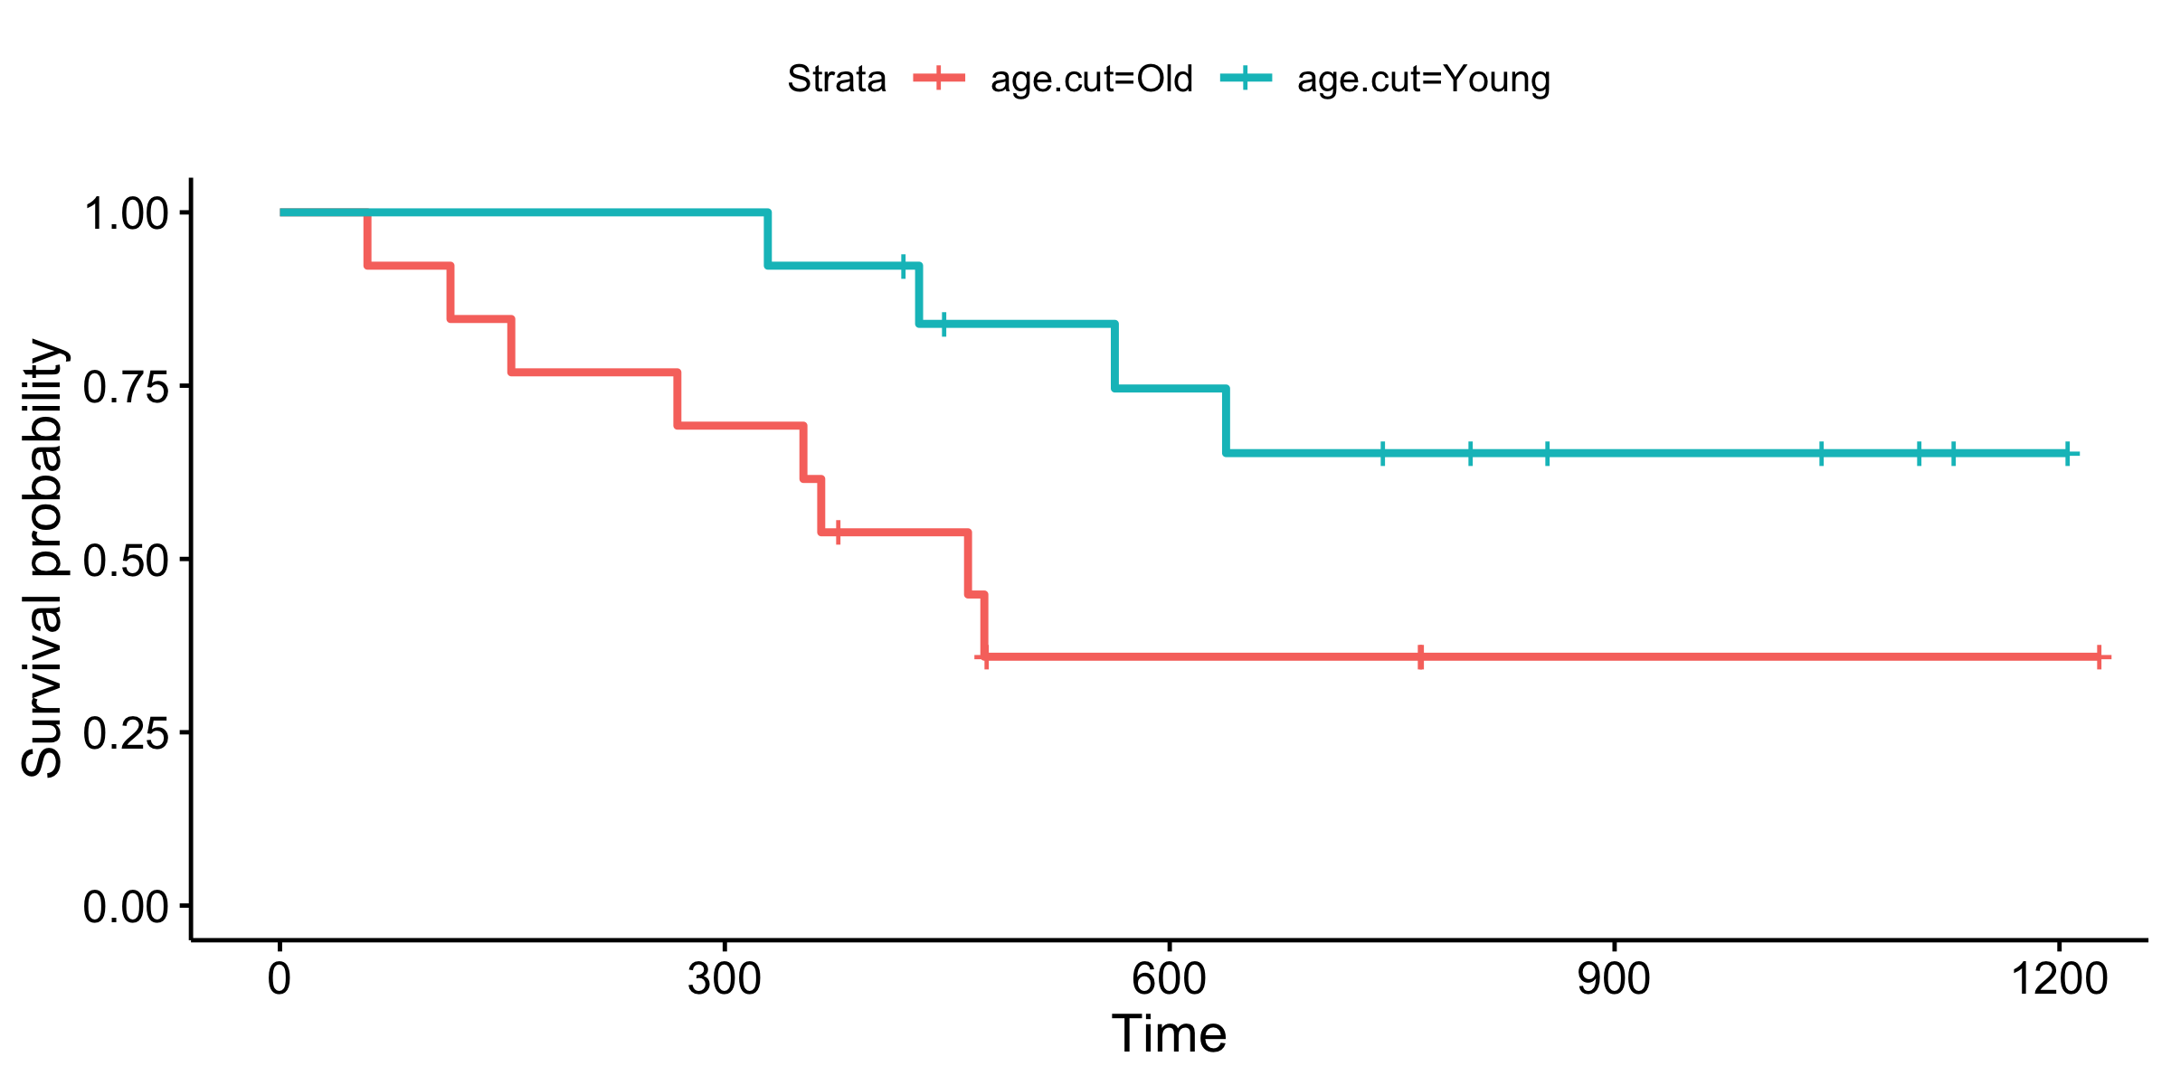
Dichotomization is the root of all evil
Discards lots of info decreasing power
Cutpoints are often arbitrary
Median? Mean?
What is high? What is low?
What is old? What is young?
What is fast? What is slow?
How many groups?
Should we trichotomize?
Cutpoints often don’t reproduce

Slide 30
Let’s Talk Iterative Kaplan-Meier
Repeated testing inflates Type I error
Dichotomization requires more patients to find effect
No statistical literature on procedure
MCMC simulation needed to correct p-values
Iterative Kaplan Meier should be avoided
Use Cox regression instead
Baldock 2014

Slide 31
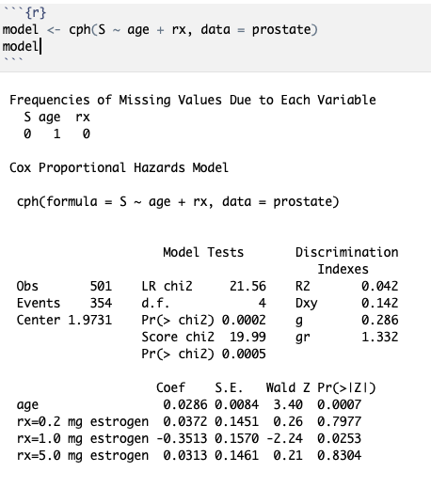
Cox Proportional Hazards Regression
Example: cph function from rms package
Multiple regression model
Model continuous variables
Account for nonlinearity
Adjust for covariates
Make risk predictions
Addresses many limitation of Kaplan-Meier estimates

Slide 32
Interpreting Cox Model
Coef = ln(Hazard Ratio)

Slide 33
Interpreting Cox Model
Coef = ln(Hazard Ratio)
S.E. = Standard Error

Slide 34
Interpreting Cox Model
Coef = ln(Hazard Ratio)
S.E. = Standard Error
Pr(>|Z|) = p-value

Slide 35
Interpreting Cox Model
HR = 1: No difference
HR < 1: Better survival
HR > 1: Worse survival
Beware!
Difference in HR vs ln(HR) scale
Direction of effect can be flipped by coding

Slide 36
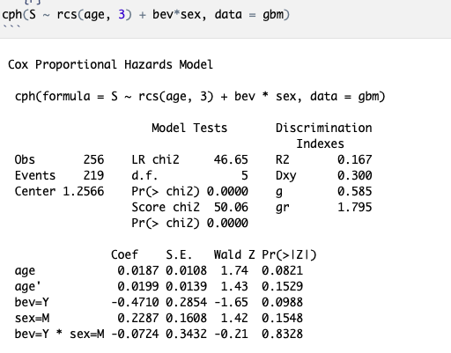
Patient Heterogeneity: Subgroup Analysis
Different treatment effect in different groups
Use interaction term to test for heterogeneity
Check for significance with anova()
If significant must interpret effects differently!

Slide 37
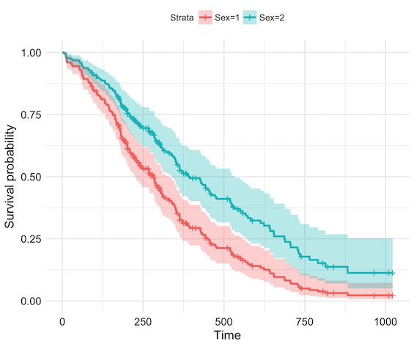
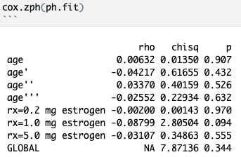
Check your model’s assumptions
Cox assumes hazard ratio constant over time (proportional hazards)
If PH not met:
Try non-linear fits for continuous variables
Stratify by variable
Time dependent interaction
Switch to AFT models

Slide 38

Check your model’s assumptions
Cox assumes hazard ratio constant over time (proportional hazards)
If PH not met:
Try non-linear fits for continuous variables
Stratify by variable
Time dependent interaction
Switch to AFT models
Don’t Cross Streams (Curves)!

Slide 39
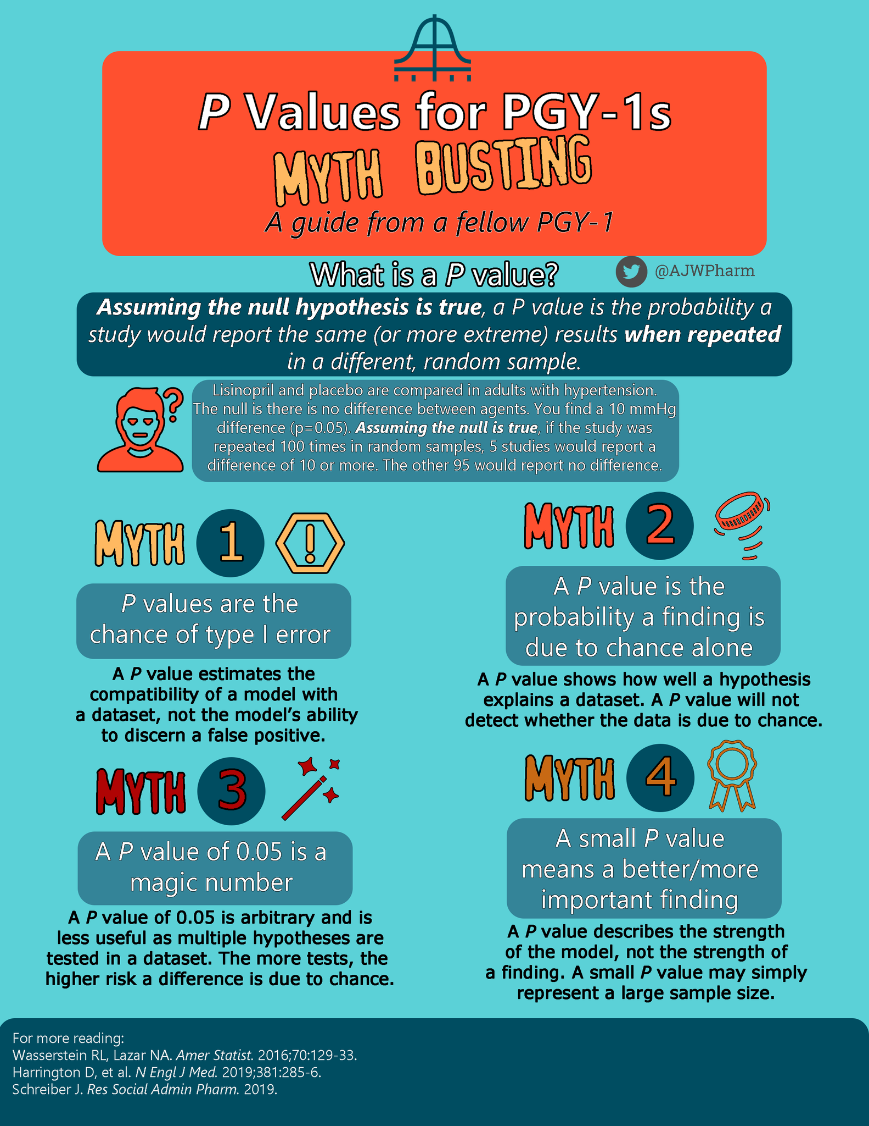
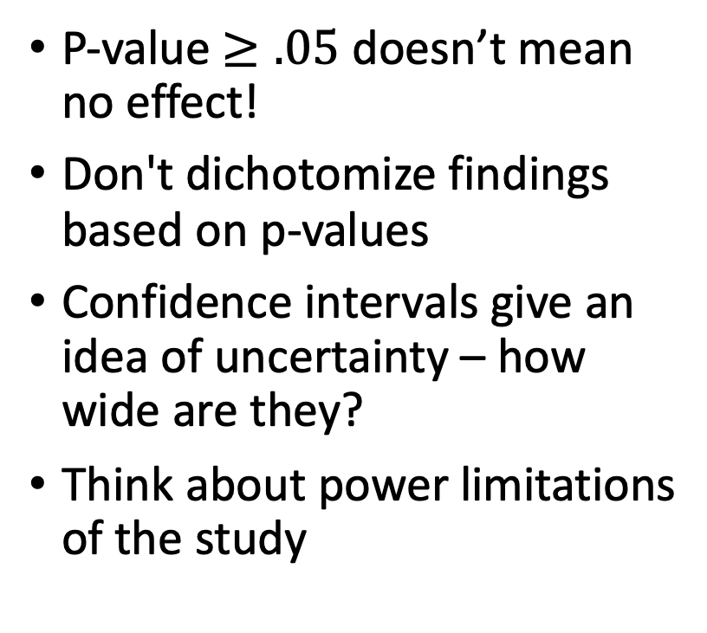
Interpreting Results
P-value $≥.05$ doesn’t mean no effect!
Don't dichotomize findings based on p-values
Confidence intervals give an idea of uncertainty – how wide are they?
Think about power limitations of the study
Andy Webb PharmD on Twitter 2019

Slide 40
Reporting Results
Report confidence intervals
Don’t dichotomize findings – use CIs
Report prespecified vs exploratory analyses
https://rpkgs.datanovia.com/survminer/reference/ggforest.html

Slide 41
There’s Always More Out There…
Non-linear effects
Evaluating biomarker efficacy
Validating prediction models
Data reduction strategies
Modeling in high dimensional spaces
Simulation experiments and power calculations
Randomized controlled trial design
Multiple comparisons correction
Data visualization
Ask us if you want more info on any of these topics!

Slide 42
Questions?
Uses Cox Regression
I’m something of a statistician myself

Slide 43
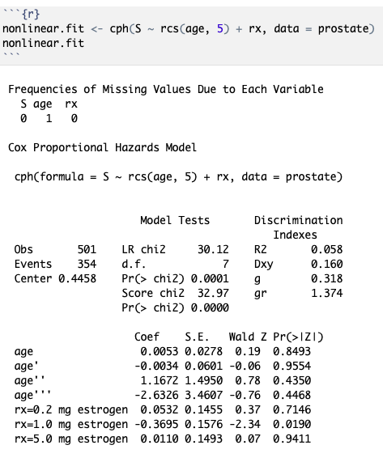
Modeling Nonlinear Effects
Restricted cubic splines relax linearity assumptions
Use rcs() function in R
Number of knots determine how well spline fits data
Use 3 to 5 knots depending on how much data you have

Slide 44
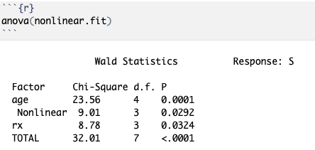
Interpreting (Non-linear) Cox Model
Use anova() to test if variable is associated with prognosis
Only gives p-value not effect size
Need to plot predictor vs HR for nonlinear variables to see effect

Slide 45
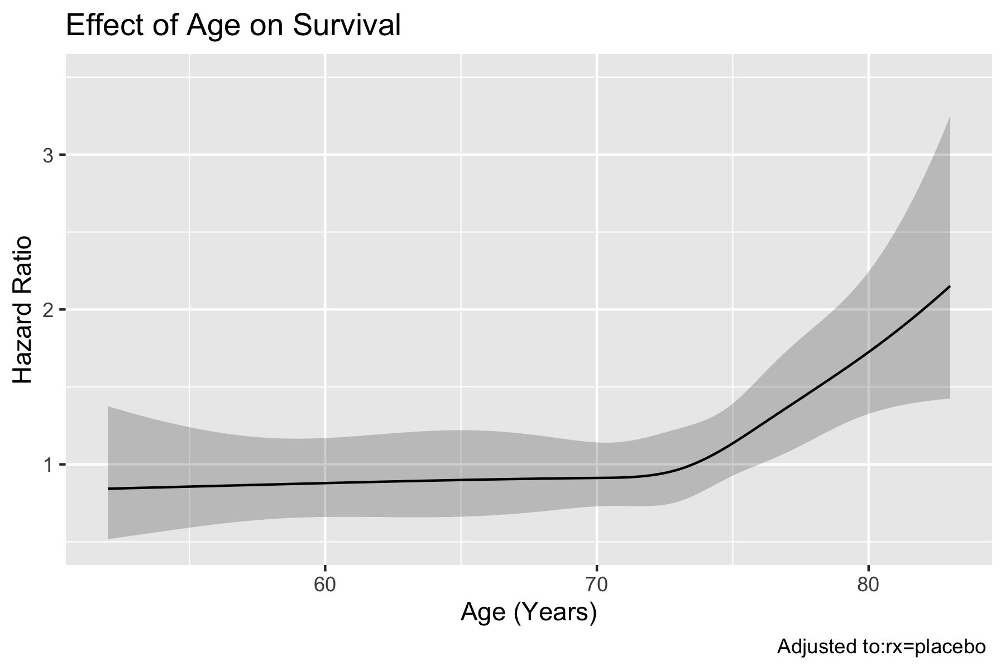
Plotting Predictor vs HR
HR = 1: No difference
HR < 1: Better survival
HR > 1: Worse survival
Beware HR vs ln(HR) scale

